Slide 1
Should there be a mandatory code of conduct for all data scientists?
Ethics & communication project
Lenka Rozborilova
2020-12-11

Slide 2

Rising awareness of the harmful power of data
No official code of conduct
No requirement for data scientists to hold any specific qualification

Slide 3
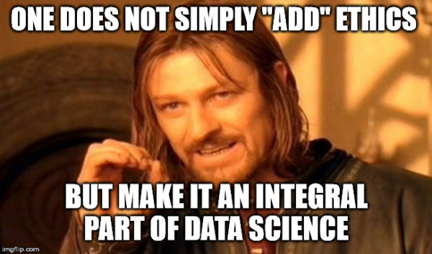
Existence of optional codes of conduct
Education and debate

Slide 4
References:
Data Ethics Canvas:
https://theodi.org/wp-content/uploads/2019/07/ODI-Data-Ethics-Canvas-2019-05.pdf
Is It Time for a Data Scientist Code of Ethics?
https://towardsdatascience.com/is-it-time-for-a-data-scientist-code-of-ethics-210b4f987a8
Professional ethics and codes of conduct:
https://www.iaa.govt.nz/for-advisers/adviser-tools/ethics-toolkit/professional-ethics-and-codes-of-conduct/

